Slide 1
Coursera Capstone IBM Applied Data Science Capstone
Opening a New Thai Restaurant in Kuala Lumpur, Malaysia
By Arif Zahari
Aug 2020

Slide 2
Business Problem
Location of the restaurant is one of the important decisions whether the business will be successful or not.
Kuala Lumpur, Malaysia is overcrowded with restaurants.
Objective: To analyze and select the most optimal neighborhoods to open a new Thai restaurant. Specifically, this report will be targeted to stakeholders interested in opening a Thai restaurant in Kuala Lumpur, Malaysia.
Business question:
If a potential restaurant owner is looking to open a new Thai restaurant, where would you recommend?

Slide 3
Data
List of neighborhoods in Kuala Lumpur
➢Latitude and longitude coordinates of the neighborhoods
➢Venue data, particularly data related to shopping malls
Sources of data
➢Wikipedia page for neighborhoods
(https://en.wikipedia.org/wiki/Category:Suburbs_in_Kuala_Lumpur)
➢Geocoder package for latitude and longitude coordinates
➢Foursquare API for venue data

Slide 4
Methodology
Web scraping Wikipedia page for neighborhoods list
Get latitude and longitude coordinates using Geocoder
Use Foursquare API to get venue data
Group data by neighborhood and taking the mean of the frequency of occurrence of each venue category
Filter venue category by “Thai Restaurant”
Perform clustering on the data by using k-means clustering
Visualize the clusters in a map using Folium

Slide 5
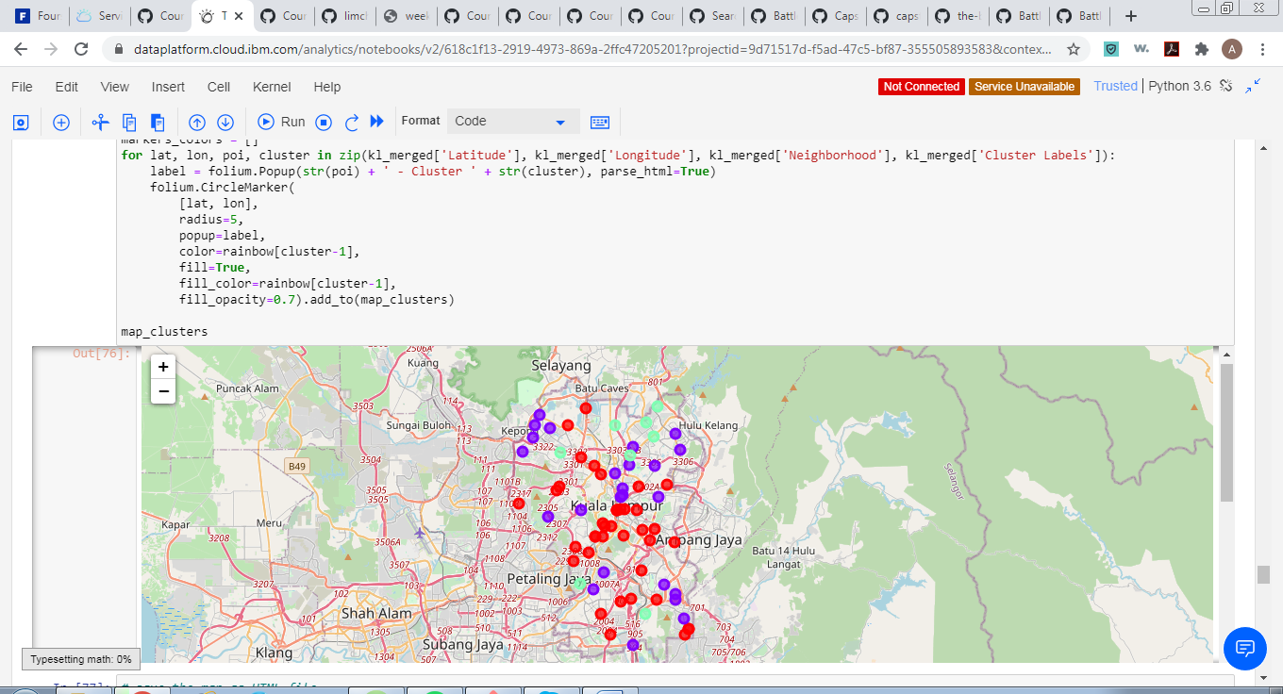
Results
Categorized the neighborhoods into 3 clusters :
➢Cluster 0: Neighborhoods with low number to no Thai restaurants
➢Cluster 1: Neighborhoods with moderate number of Thai restaurants
➢Cluster 2: Neighborhoods with high concentration of Thai restaurants
Cluster 0 in red color, cluster 1 in purple color, and cluster 2 in mint green

Slide 6
Discussion
Most of the Thai restaurants are concentrated in the suburb of the city
Highest number in cluster 2 and moderate number in cluster 1
Cluster 0 has very low number to no Thai restaurants in the neighborhoods
Oversupply of Thai restaurants mostly happens in the suburb of the city, with the central city with low supply

Slide 7
Conclusion
Answer to business question: The neighborhoods in cluster 0 are the most preferred locations to open a new Thai restaurant
Findings of this project will help the relevant stakeholders to capitalize on the opportunities on high potential locations while avoiding overcrowded areas in their decisions to open a new Thai restaurant

